Slide 1

Week 8 – Information Design
Programming 02

Slide 2
Change of Schedule for Lecture and Lab Sessions in May
The lecture and lab originally scheduled for Monday, May 5th, has been rescheduled to Wednesday, May 7th. The updated details are as follows:
Lecture:
New Time: 14:00 - 15:00
Location: TW/007 - Temple Hall (Room 248)
Lab:
New Time: 15:00 - 18:00
Location: C/114 and CC/115

Slide 3
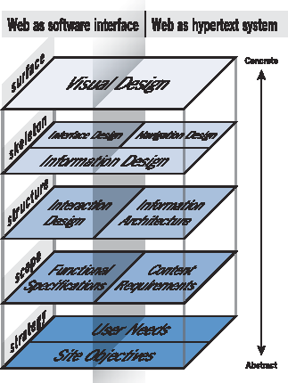
UX Design - Skeleton
Source: Garrett, 2002

Slide 4
Information Design
Information design is the practice of combining visual elements, content and form to communicate effectively.
Communicating effectively means providing the right information to the right person at the right time.
The main goal in information design is clarity of communication.

Slide 5
Information Design
Information Design refer to the process of organizing, structuring, and presenting information in a way that enhances understanding and usability for users.
It combines principles from graphic design, information theory, and cognitive psychology to ensure that content is not only visually appealing but also easy to interpret and navigate.

Slide 6
Information Design vs. Interaction Design
Focus:
Information design concentrates on the organization and presentation of information (how it is displayed, structured, and categorized), while interaction design focuses on how users interact with that information (the interactions, feedback, and behaviours).
Activities:
Information design may involve creating sitemaps, wireframes, and information hierarchies. In contrast, interaction design involves designing user flows, defining how users will navigate the interface, and specifying interactive elements like buttons and sliders.

Slide 7
Information Design vs. Visual Design
Focus:
Information design is concerned with the clarity and accessibility of information, ensuring that users can easily understand and find what they need. Visual design emphasizes the aesthetics and visual appeal of the interface, including colour schemes, typography, imagery, and overall style.
Activities:
While information design prioritizes structuring information for comprehension, visual design focuses on how that information is visually represented and styled. For example, visual designers decide the colour palette and layout, while information designers ensure that these choices enhance understanding and usability.

Slide 8
Information Design vs. Content Strategy
Focus:
Content strategy is concerned with the planning, creation, and management of content throughout the user journey. Information design focuses specifically on how that content is organized and presented to facilitate understanding.
Activities:
Content strategy involves defining the types of content needed, voice and tone, and managing content updates, while information design addresses how to structure and visually present that content effectively to users.

Slide 9
Information Design Techniques
Grouping of related information.
Organising and labelling information for coherent, non-linear access.
Cross-linking to provide redundant access to topics.
Matching order or flow of information to user task flow.
Using familiar terminology.
Ensuring that essential information is readily available and easy to find, typically through clear labelling, prominent placement, or shortcuts

Slide 10
Information Design
It is the use of:
Plain writing/language.
The layout/organisation and logical grouping of related pieces of information.
The appropriate use of colour and typography.
The effective management of white space.

Slide 11
Plain Writing
Plain writing (also known as plain English or language) is a way of writing or presenting information so that readers can understand it quickly and easily. Plain language should be easy to read, understand, and use. Plain language avoids verbose or convoluted language, jargon, euphemism, and ambiguous language.
“Broadly speaking, the short words are the best, and the old words, when short, are best of all”.
- Winston Churchill
“Any fool can make things bigger, more complex, and more violent. It takes a touch of genius-and a lot of courage-to move in the opposite direction”.
- Albert Einstein

Slide 12
Plain Writing Examples
Example 1:
Before – “The Dietary Guidelines for Americans recommends a half hour or more of moderate physical activity on most days, preferably every day. The activity can include brisk walking, home care, gardening, moderate sports exercise, and dancing."
After – “Do at least 30 minutes of exercise, like brisk walking, most days of the week.“
Example 2:
Before – “High-quality learning environments are a necessary precondition for facilitation and enhancement of the ongoing learning process.”
After – “Children need good schools if they are to learn properly.”
Plain English Campaign: https://www.plainenglish.co.uk/campaigning/example s/before-and-after.html

Slide 13
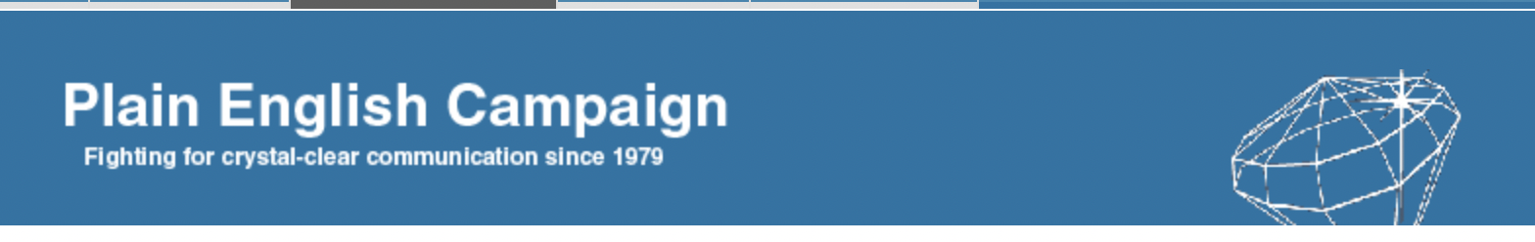
Plain Writing Examples
Examples from the Golden Bull Awards.
Example 3:
Department of Health Website
Before – “Primary prevention includes health, promotion and requires action on the determinants of health to prevent disease occurring. It has been described as refocusing upstream to stop people falling in the waters of disease.”
After – “Doctors can prevent disease before it occurs.”
Example 4:
Lord Mandelson on MPs' expenses (Foot in Mouth award winner)
Before – “Perhaps we need not more people looking round more corners but the same people looking round more corners more thoroughly to avoid the small things detracting from the big things the Prime Minister is getting right.”
After – “MPs don't need more scrutiny, just better scrutiny.”

Slide 14
Plain Writing Examples
Example 5:
Coca Cola letter to distributors
Before – “To outsource some aspects of our finance transactional processing activities... we will be transitioning certain transactional activities... there will be two primary impacts to your organisation... does not impact your current terms... aiming to minimise any disruption to our business, and we expect our performance levels to stabilise soon after the transition period.”
After – “We’re changing our payment arrangements. Here’s how it affects you.”
Each of these examples are quicker to read and easier for users to read, which helps increase audience satisfaction.
While it is okay to have more in-depth information for specific pages, landing pages like the home page should contain plainer language to grab the user's attention and avoid confusing readers.

Slide 15
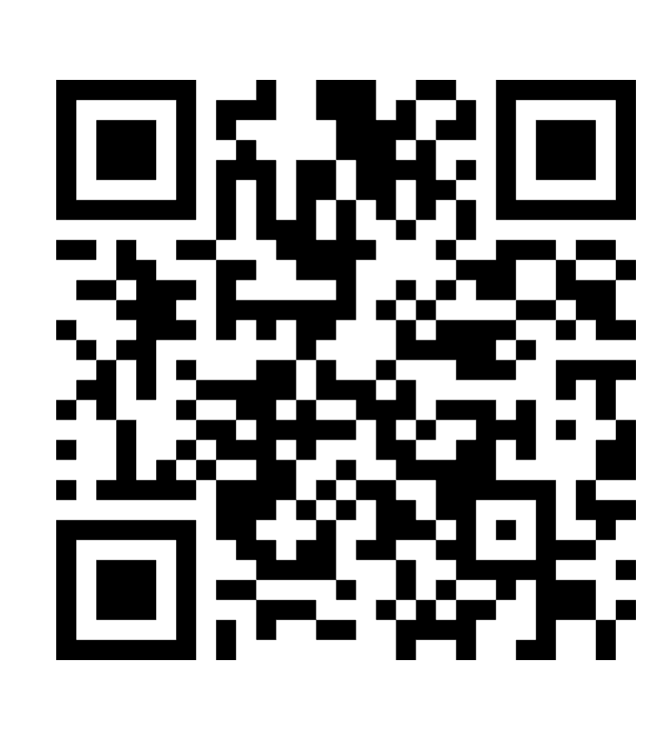
Exercise
Rewrite the passages in this Mentimeter to speak more directly to the reader.

Slide 16
Organisation with Patterns
One of the key aspects with how we design our information is controlling the flow of information.
We often do this with principles like the inverse pyramid principle to introduce the most important information first and then follow with subsequently less and less important information.
Though to effectively do this we need to consider where our viewers eyes will initially focus and where they will then go.
As such we need to design our pages to control the users focus to guide them towards the goal.
The main two patterns of landing page designs are F and Z patterns.

Slide 17
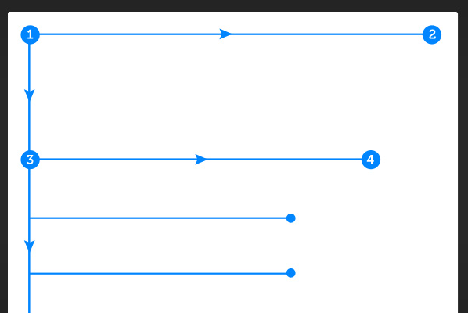
Behaviour Pattern
The general behaviour pattern:
Visitors start at the top left of the page.
Then they scan the top of the site (navigation, subscription, search, etc.)
Next, they move down, reading the next full row of content… all the way to the sidebar.
Last, surfers enter a “scanning pattern” once they hit the bulk of the site content.

Slide 18
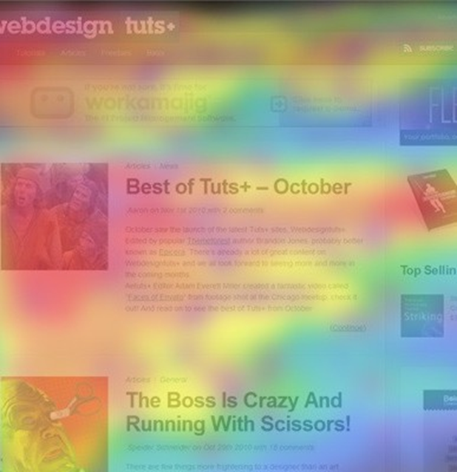
Organisation F Pattern
This heatmap shows the abstract F shape that users generally gravitate towards. Hot spots (red/orange/yellow) represent where user’s attention lingers the longest. (Eye tracking studies eye-tracking studies argue in favour of placing the most important elements of your site (branding, navigation, call to action) on the left side of the design.

Slide 19
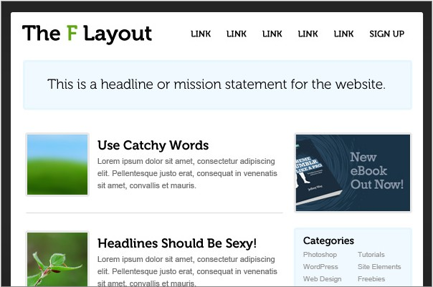
Organisation F Pattern
You’ll notice that the main intent of the site is now communicated within a few seconds.
The top row of content is now fulfilling its duty to “orient” the visitor; If your navigation is here, they also know where they can go. Below the top row, we’re using images and “catchy” headlines to grab a surfer’s attention… even if they are only interested in scanning the content, there’s a good chance they’ll be able to find something of interest.
We’re also trying to capitalise on the second-row of the “F” by placing an advertisement or “call to action” here.

Slide 20
Organisation F Pattern
Why it Works
The F-Layout works because it allows web-surfers to scan content naturally. The layout feels comfortable because people have been reading top to bottom, left to right for their entire lives.
If you need to say something, you absolutely must say it at the top.
Users aren’t going to read each and every word on the page. In fact, most readers won’t really even bother reading the excerpt of an article.
Images and Headlines are only reliable if they are interesting and engaging.

Slide 21
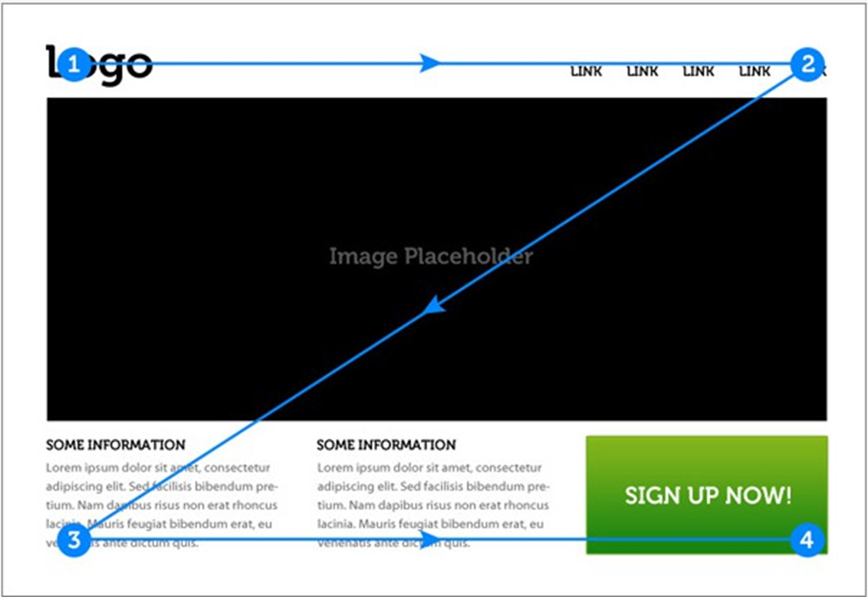
Organisation Z Pattern
An alternative to the F layout is the Z layout.

Slide 22
Organisation Z Pattern
This layout quickly and effectively moves the eye from Point 1 to Point 4 in a logical order – concluding with a powerful call to action. To implement this, it can be supplemented by:
Background separation to focus the eye movement inside the framework of our design.
A styled logo to grab the user’s attention at point #1.
A colourful “sign up” button at point #2: this will reinforce the desired eye movement.
A Featured Image Slider in the centre of the page: this will separate the top section of the design from the bottom and facilitate eye movement downward.
Icons at point #3 and along the bottom axis: this will encourage “title scanning” as the eye moves to the call to action.
A big “call to action” at point #4 – thanks to the new background separation, this feature should stand out more.

Slide 23
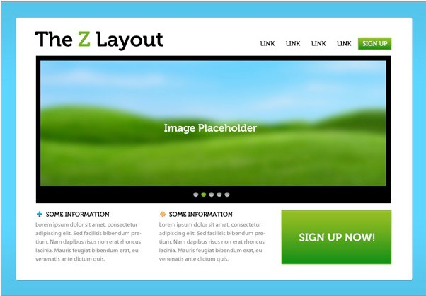
Example Z Pattern

Slide 24
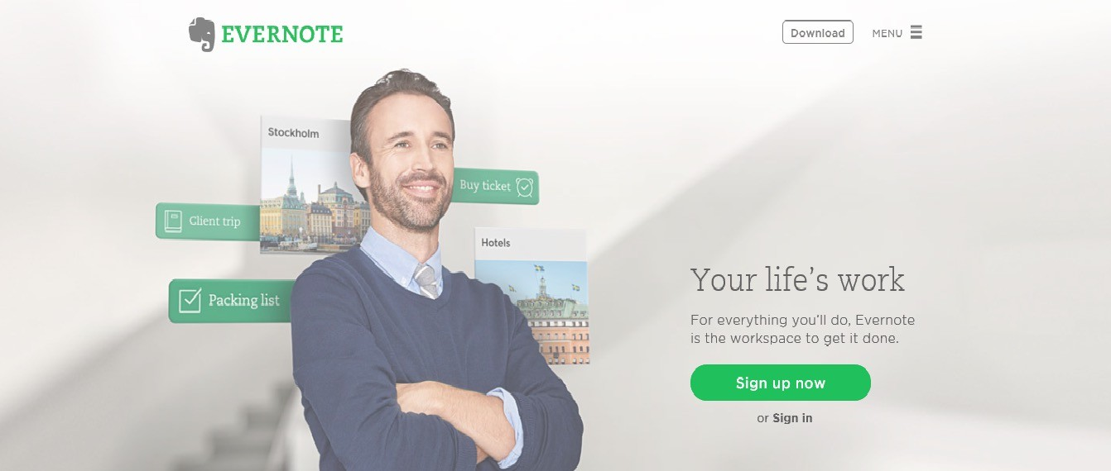
Example Z Pattern

Slide 25
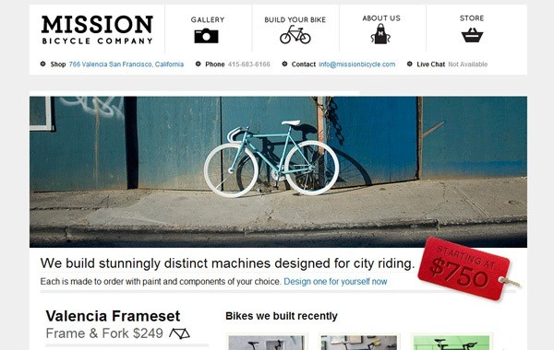
Example Z Pattern

Slide 26
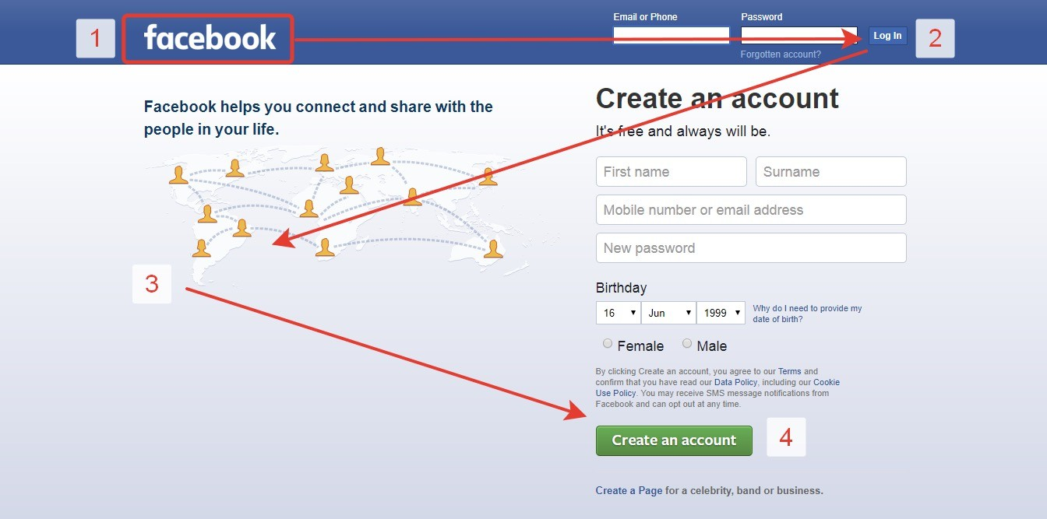
Organisation Z Pattern
Why it Works
The Z-Layout certainly doesn’t need to be the only concrete solution for all sites, it’s often a great jumping off point for any design project because it tackles the 4 of the big principles of an effective design:
Branding
Hierarchy
Structure
A Call to Action

Slide 27
Outputs of Information Design
High Fidelity (Hi-Fi) prototypes including:
Organization Layouts with outline design decisions.
Final Copy of content.

Slide 28
Colour, typography & white space, we will address in the visual design lecture next week.

Slide 29
Further Reading
Interface Design
Constantine and Lockwood (1999) Interface Design Addison and Wesley
http://www.smashingmagazine.com/2008/01/31/10-principles-of-effective-web-design/
http://psd.tutsplus.com/articles/6-interface-design-principles-and-tips-every-web- designer-should-know/
Navigation Design
http://www.onextrapixel.com/2009/07/03/10-principles-of-navigation-design-and-why- quality-navigation-is-so-critical/
http://www.uxmag.com/design/web-navigation-design-workshop-with-james-kalbach
Information Design
http://www.cc.gatech.edu/projects/PageSleuth/references/p309-zimmermann.pdf
http://mkweb.bcgsc.ca/vizbi/2012/principles.pdf
31

